Slide 1
24
7
30
Date
Linear Equations
EQ – How do I solve linear equations?
An equation is a mathematical sentence. It has an equals sign with expressions on both sides.
The simplest algebraic equations are linear equations with one variable. When plotted for different values of the variable, a linear equation produces a straight line.
A solution of an algebraic equation is a value of the variable that makes the equation true.
The process of finding the solution to an equation is called solving an equation. We say that a solution satisfies the equation.
Formal solution of equations is done by using inverse operations.

Slide 2
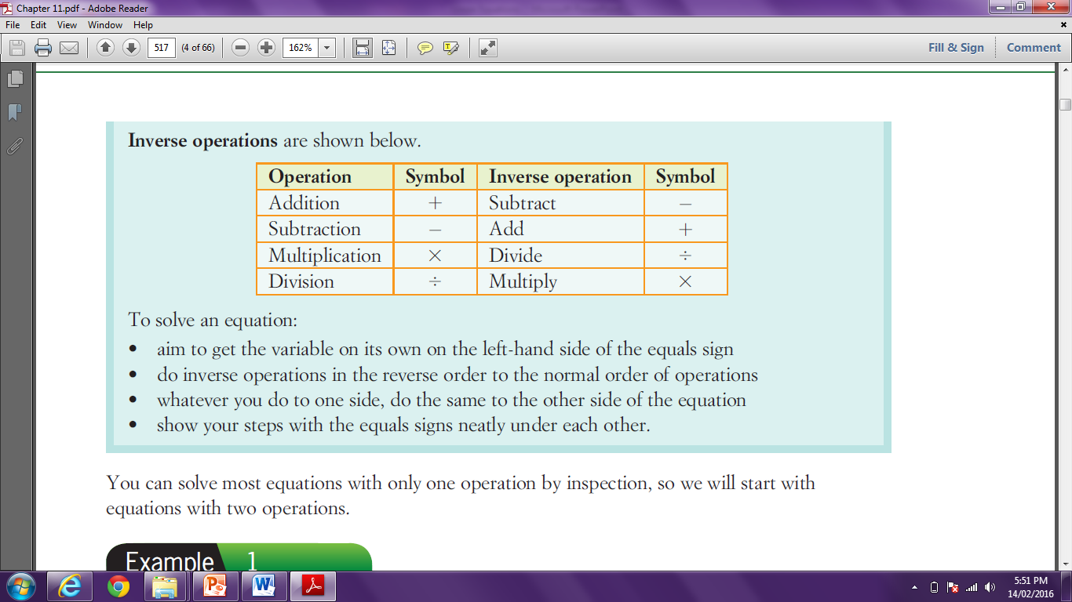
24
7
30
Date
Linear Equations
EQ – How do I solve linear equations?

Slide 3

24
7
30
Date
Linear Equations
EQ – How do I solve linear equations?
Examples:
Solve the following:
4a + 17 = 25
4a + 17 – 17 = 25 – 17
4a = 8
$\frac{4a}{4}$ = $\frac{8}{4}$
a = 2
Side with variable has × and +. Undo the + first.
Simplify
Now undo the ×
Simplify to get the answer

Slide 4
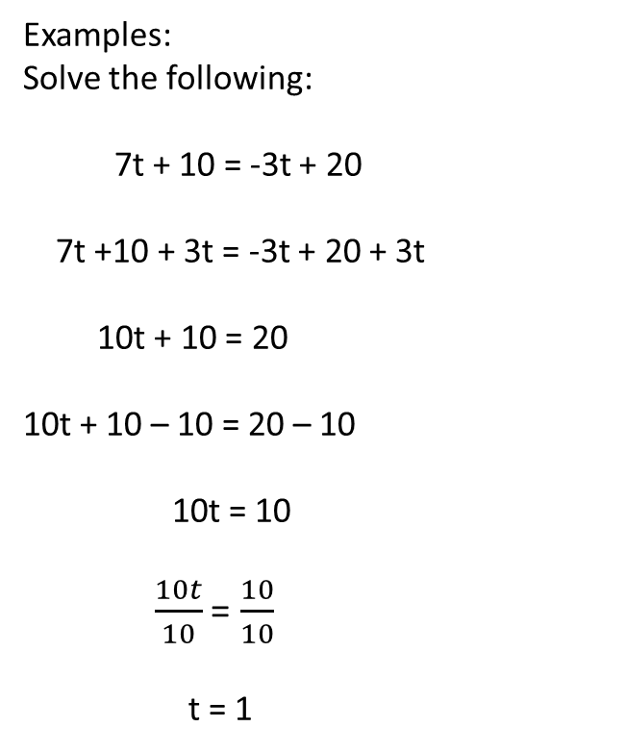
24
7
30
Date
Linear Equations
EQ – How do I solve linear equations?
Examples:
Solve the following:
7t + 10 = -3t + 20
7t +10 + 3t = -3t + 20 + 3t
10t + 10 = 20
10t + 10 – 10 = 20 – 10
10t = 10
$\frac{10t}{10}$ = $\frac{10}{10}$
t = 1
Get the variables on one side
Simplify
Now undo the +
Simplify
Now undo the ×
Simplify to get the answer

Slide 5
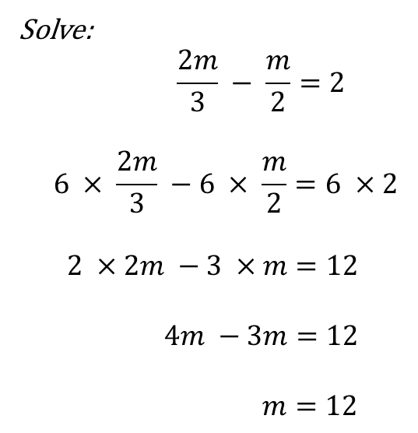
24
7
30
Date
Linear Equations
EQ – How do I solve linear equations?
Solve:
$$\frac{2m}{3} − \frac{m}{2}=2$$
$$6 × \frac{2m}{3} −6 × \frac{m}{2}=6 ×2$$
$$2 ×2m −3 ×m=12$$
$$4m −3m=12$$
$$m=12$$
Multiply each term by the lowest
common denominator, 6.
Simplify by cancelling the denominators.
Simplify each term.
Simplify the variables.

Slide 6
Notes Review
24, 7 ,30
Date
Title
Essential question
Notes complete
Notes complete with colour and diagrams
Questions completed
Contents page filed in
Formula page filled in

Slide 7
Homework
Review your notes and write a summary answering the essential question.

